Slide 1
One Codebase: Windows, Web, Mobile
Using .NET MAUI Blazor & Blazor

Slide 2

About Your Speaker
Mitch Sellers
Microsoft MVP, ASPInsider, etc
CEO @ IowaComputerGurus, Inc.
Contact Info
msellers@iowacomputergurus.com
@mitchelsellers
www.mitchelsellers.com

Slide 3

Agenda
The Development Scenario
Overview of Tools Available
Introducing .NET MAUI Blazor
DB Architecture Patterns/Considerations
Application Options/Considerations
DevOps Considerations
Costs/Planning

Slide 4

The Development Scenario
Sometimes Mobile & Desktop Isn’t Enough
Creation of a Web interface that requires MINIMAL extra effort to manage/manipulate
Creation of an easy process to build/test/package the entire solution at once
Responsive Mobile does not provide enough options
API’s and backend logic are not included in today’s discussion

Slide 5

Tools Available Today
Xamarin (Xamarin.Forms)
Legacy iOS/Android (Uses XAML)
May 2024 EOL
.NET MAUI
XAML Based
Windows, Mac, iOS, Android, Tizen
UNO Platform
C# XAML Based
Windows, Mac, iOS, Androiz, Tizen, WASM, and Linux

Slide 6
Introducing .NET MAUI Blazor
Think of it as a web app that runs on mobile
Fully supports multiple targets, including access to device specific hardware (camera, nfc, etc)
Apple
Android
Windows
Mac
Design/Develop/Build like it is web
Introduces some minimum versions that should be understood

Slide 7
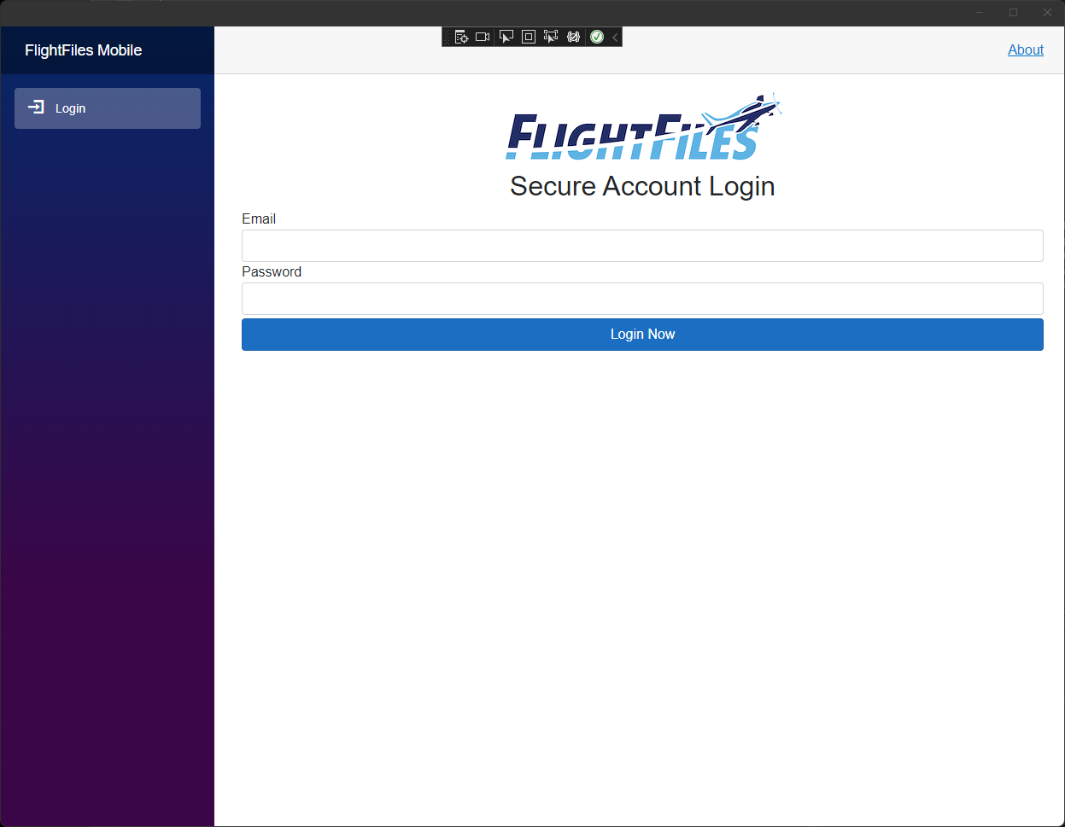
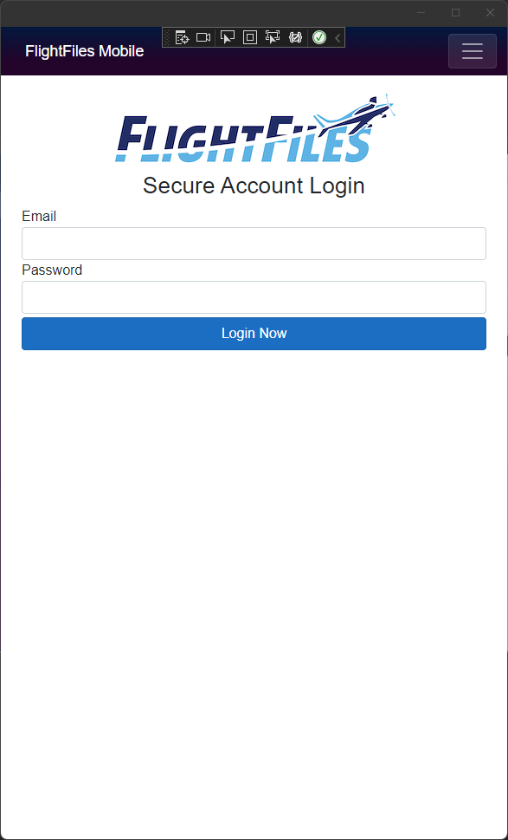
Example

Slide 8
.NET MAUI Blazor Minimum Target Versions
Requires Microsoft Edge WebView2
Minimums
Android 7.0 (API 24) – Should be a non-issue
iOS 14+ - This could be a concern
macOS 11 or higher, using Mac Catalyst

Slide 9

Some Additional .NET MAUI Blazor Tips
No concern with publishing to the App Stores, but verbiage is key in submission.
On Windows you are running a web-app, this introduces a bit of a limitation with recent Windows 11 Releases
Developer Support/Advancement is Swift, Update regularly

Slide 10
Achieving Windows/Web/Mobile
.NET MAUI Blazor
ASP.NET Core Blazor
Razor Class Library

Slide 11
Where Code Lives
High-Level Components – Components Project
View Models
Views
Routing/Page setup – Individual UI Projects
Demo Solution
https://github.com/mitchelsellers/one-codebase-for-all-demo

Slide 12

Demo & Questions

